Slide 1



Powered Lower Limb Exoskeleton
Mentor – Ms. Pujita Bhatt
Students : Dev Soni
Mihir Ruparel
Hiten Patel
Raj Dhruvrajsinh

Slide 2

Table of Content
● Introduction
● Background
● Design Of The Exoskeleton
● Controls Of The Exoskeleton
● Working Exoskeleton
● Future Scope
● References

Slide 3

Introduction
● Exoskeleton is one type of wearable robot that can be used in two major sector.
Exoskeleton
● Medical Sector
→ In the medical sector, the exoskeleton is being used for the rehabilitation of paraplegic patients to regain their walking capability.
→ Exoskeleton provides walking assistance to the patients.
→ Always has the active joint at the patients paralysed joint.
● Industrial Sector
→ In the industrial sector, the exoskeleton is being used for enhancing the performance of the workers who does the repetitive tasks like weight lifting work or over-head work.
→ Exoskeleton provides the partial assistance.
→ It can has either active or passive joint.

Slide 4
Background
● Kinematic chain of the human lower limb
(Ball-Socket joint)
hip joint 3 DoF
+ Knee joint 1 DoF
+ Ankle joint 2 DoF
(Revolute joint)
Total One leg has 6 DoF
(Plane joint)
Figure 1. Kinematic chain of human leg

Slide 5
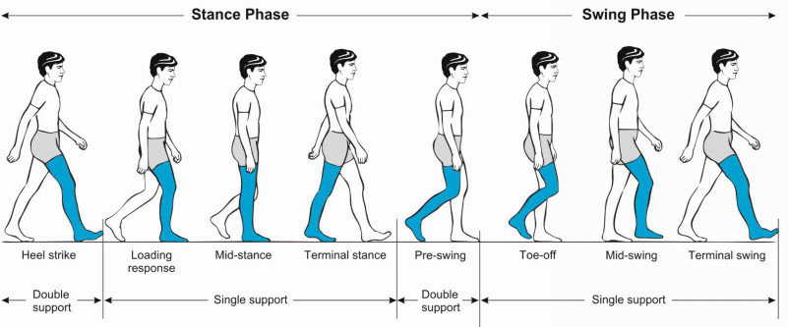
● Walking gait of the human
● Gait is the pattern of movement of the limbs of humans, during locomotion over a solid surface. All humans use a variety of gaits, selecting gait based on speed, terrain and the need to maneuver.
● Human walking gait with different phases showed below.
Figure 2 – Human walking gait pattern

Slide 6
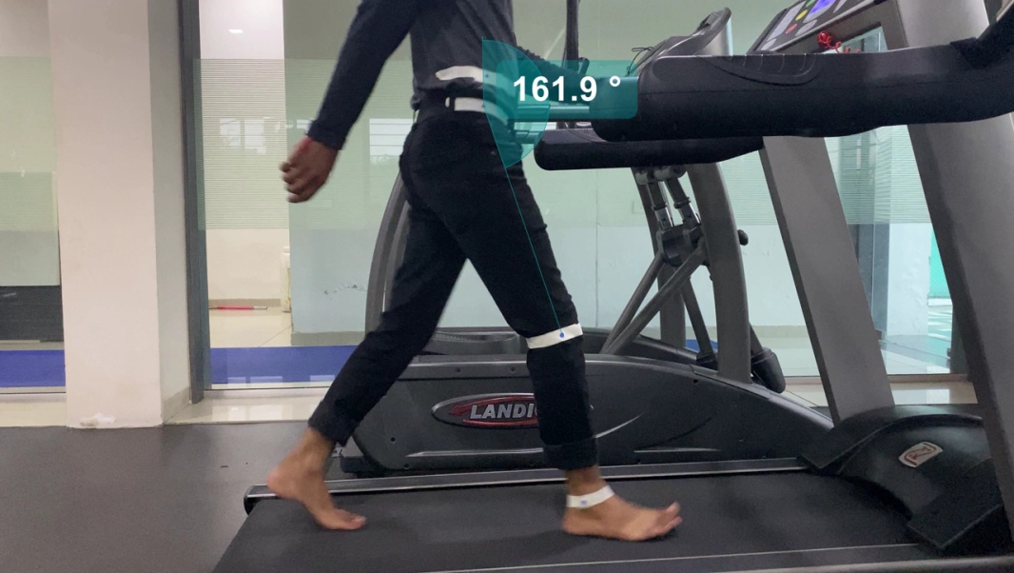
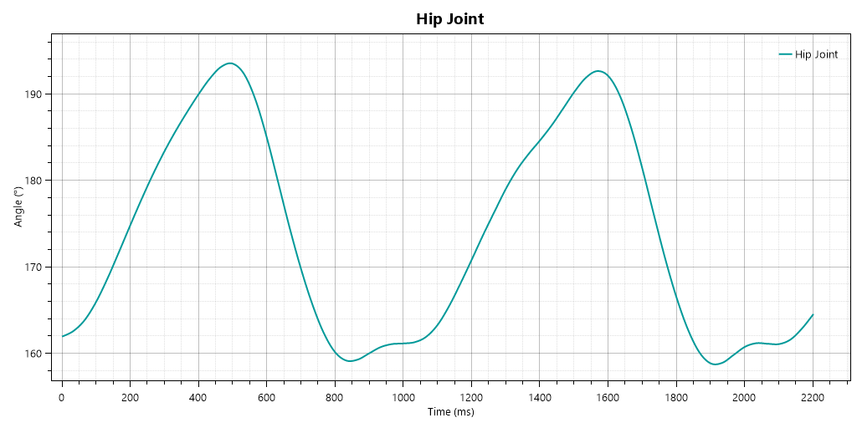

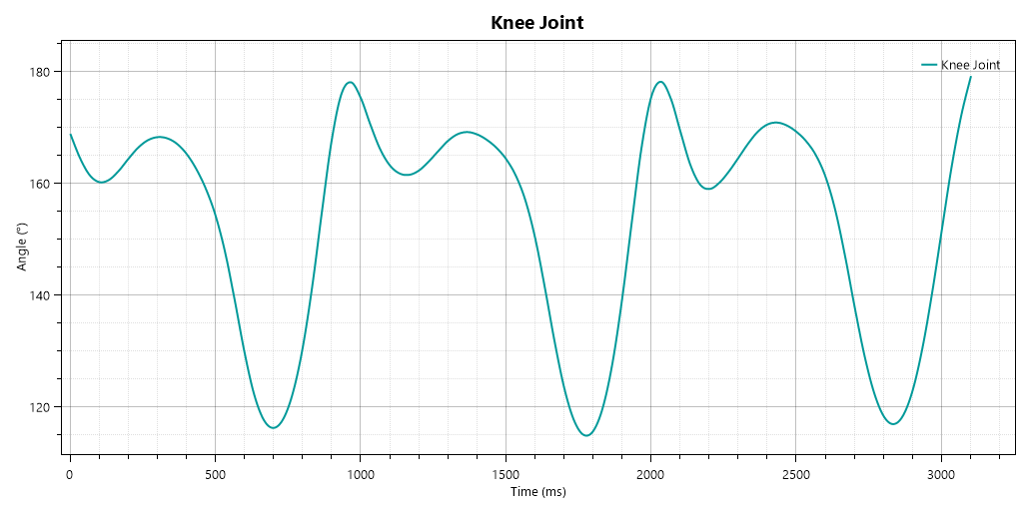
● Gait analysis with the use of kinovea software
→ Gait trajectories plotted with the use of kinovea software, these gait trajectories used for the PID control input.
→ Hip joint analysis & trajectory
→ Knee joint analysis & trajectory

Slide 7
Design of the exoskeleton
● The design of the exoskeleton should produce torque that is needed to actuate human joints. Different lower limb joints require different torques.
● The results of the torque study of lower limb joints and consequent design of the exoskeleton presented.
Study conducted on a perspective who has 80kg weight and 180cm height:
The hip joint requires the peak torque – 60Nm
The knee joint requires the peak torque – 40Nm approximately.
Sources mentioned in the reference section.

Slide 8
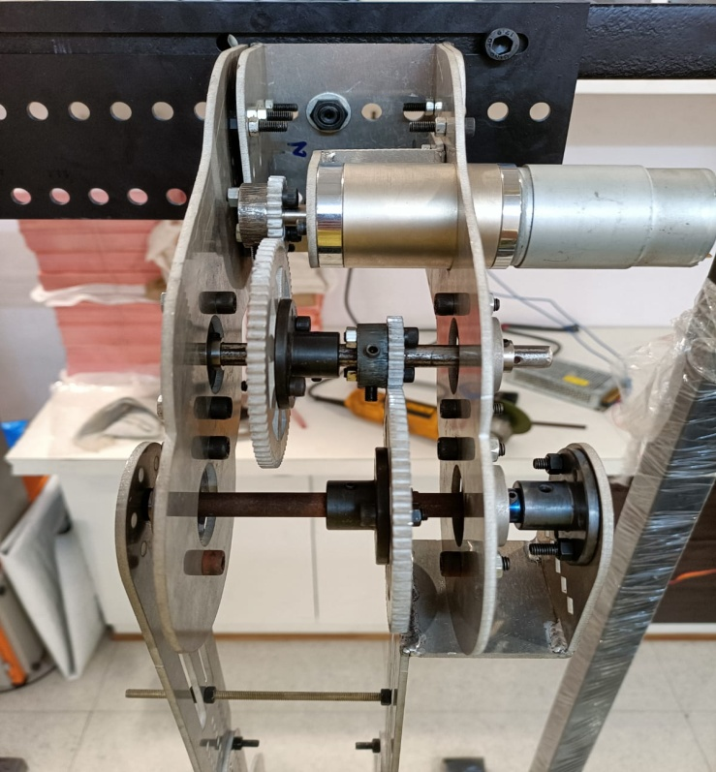
● Actuator selected and gear designed in such a way that satisfy the torque requirements of the hip and knee joint.
● RS - 550 DC motor with the P60 planetary gearbox selected which can produce peak torque up to 7.128Nm.
● For the hip joint 2 layer compound spur gears design with the 3:1 reduction ratio at each layer, output torque of the hip joint = 7.128 * 9 = 64.152Nm.
RS-550 DC motor
25teeth driver gear
25teeth 2nd layer driver gear
75teeth 1st layer driven gear
2nd layer driven gear 75teeth gear
Figure 5. Hip Joint, 9:1 compound gears

Slide 9
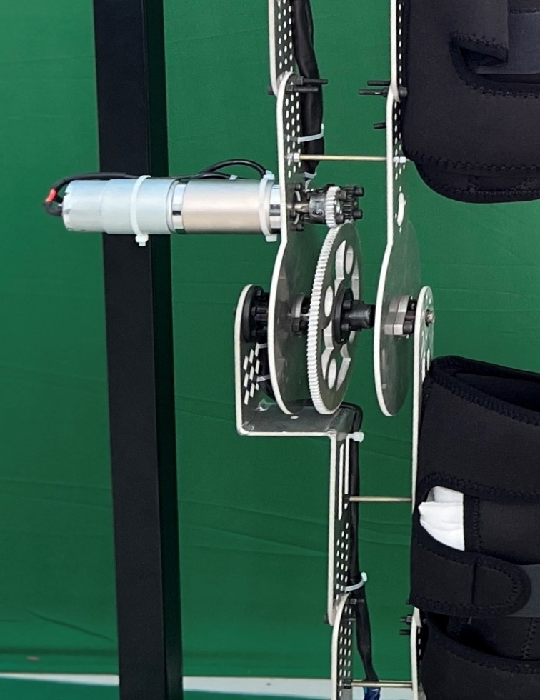
● For the knee joint spur gears with the 5:1 reduction ratio is selected which can give peak torque = 7.128*5 = 35.64Nm.
RS-550 DC motor
25 teeth driver
125 teeth driven
Figure 6. Knee Joint, 5:1 ratio gears

Slide 10
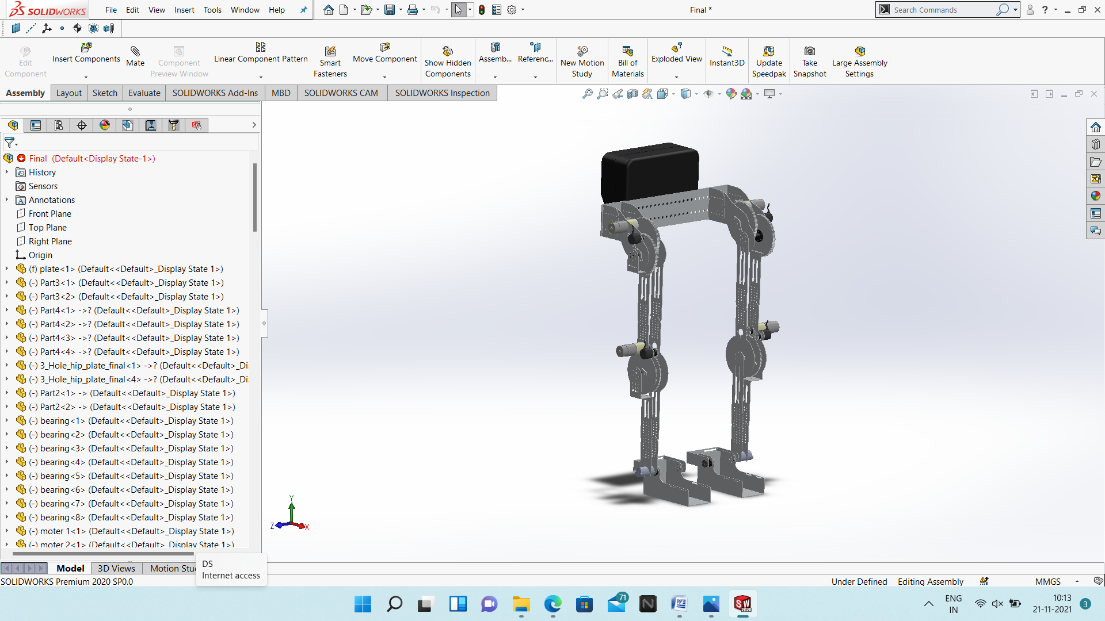
● High strength aluminum alloy 6082 selected for the frame design of the exoskeleton which provides the light weight and robust structure for exoskeleton body & Exoskeleton Designed with 6 DoF (1 hip, 1 knee, 1 ankle joint of each leg).
● Each part of the exoskeleton designed with the use of solidworks software and rendered through solidworks visualize professional.
Figure 7. Solidworks design

Slide 11
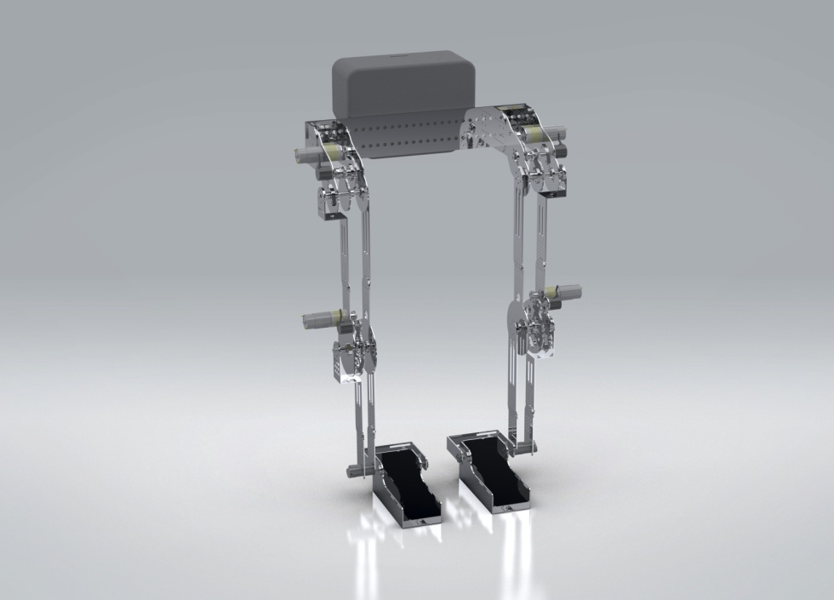
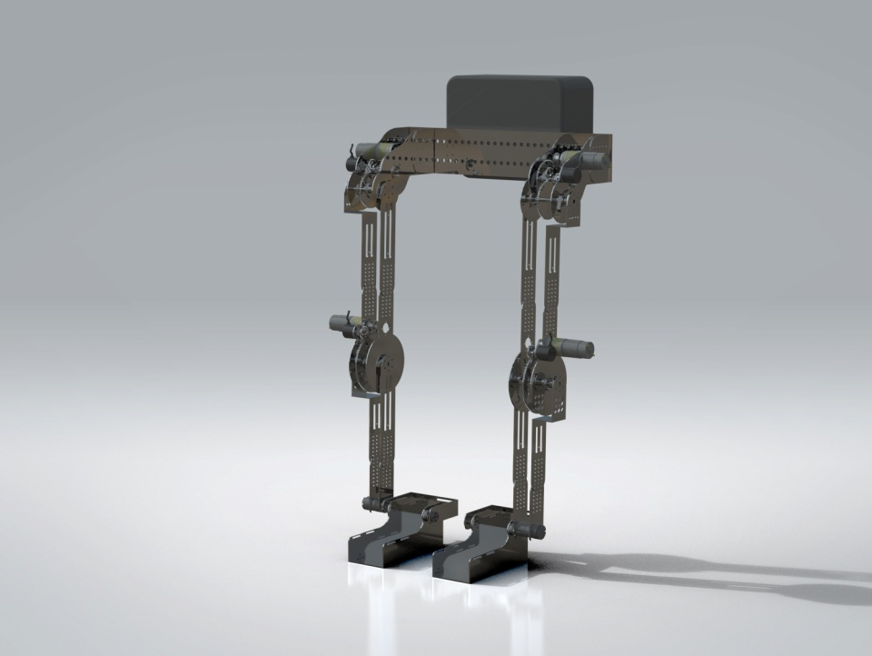
Figure 8. Rendered Images In Solidworks Visualize Professional

Slide 12
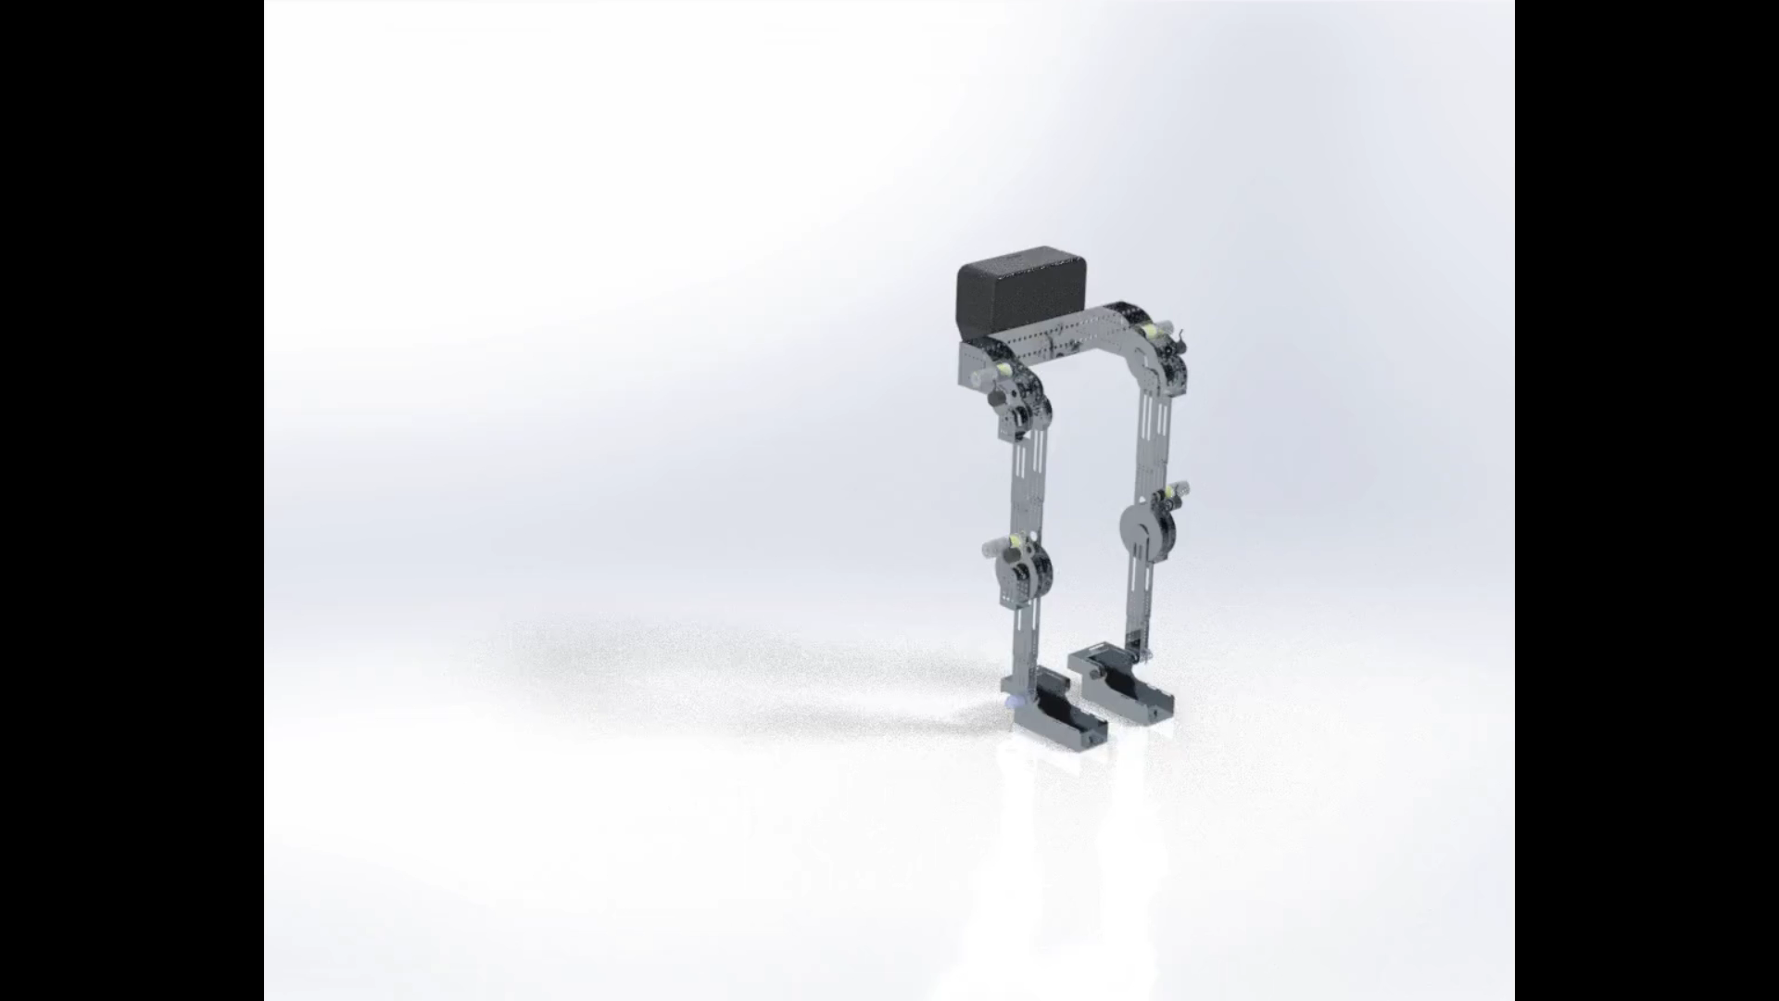
● Assembly Animation Rendered Through Solidworks Visualize Studio

Slide 13
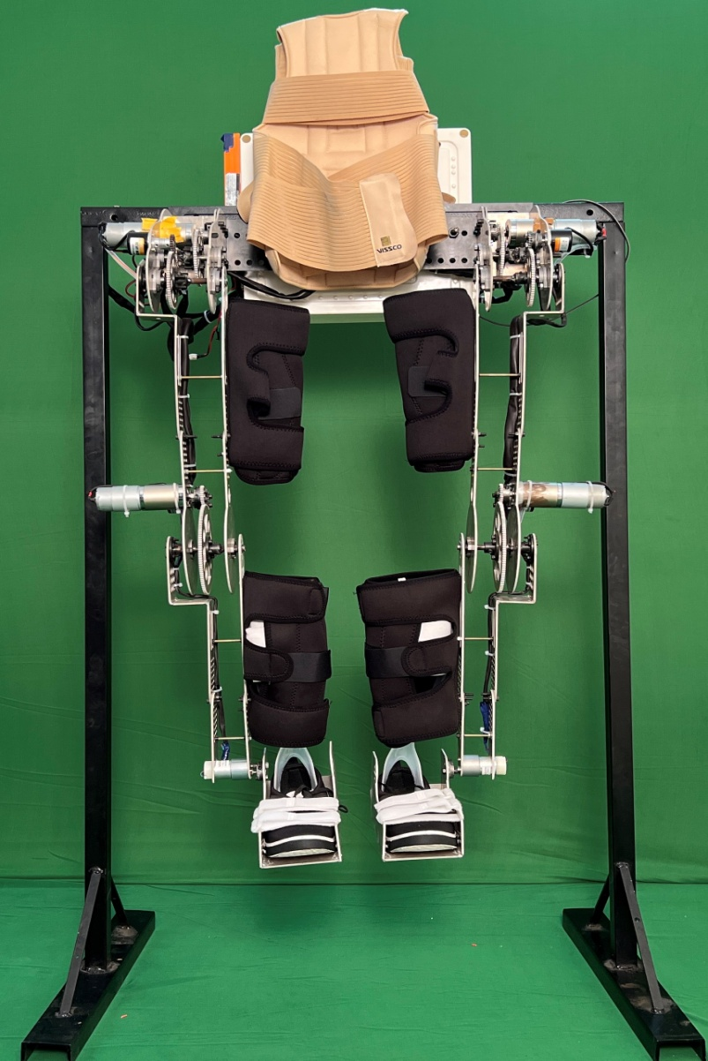
● Supporting braces and straps attached for wearers comfort.
Support brace for torso
Support braces for thigh
Braces for shank
Figure 9. Support Mountings

Slide 14
Controls Of The Exoskeleton
Control Signals
Reference Angles Input
PID Controller Running on Microcontroller
PWM
Motor Drives
Actuators
(Motors)
Feedback by encoders
Encoders
Figure 10. Control Block Diagram

Slide 15
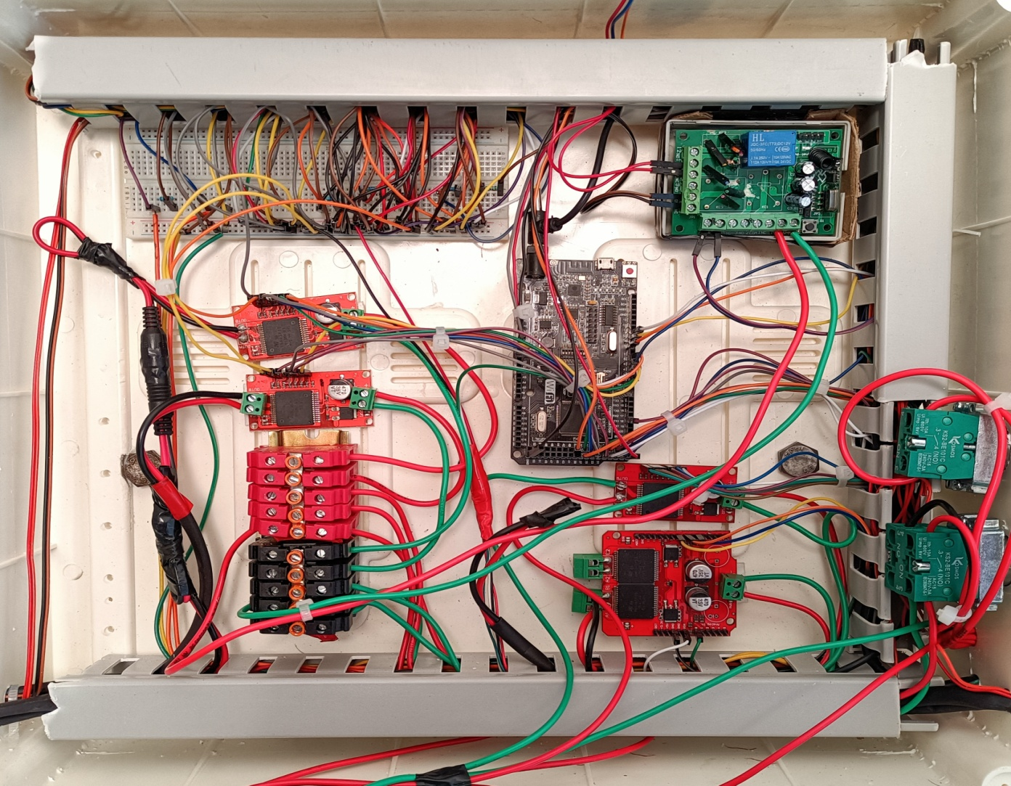
● Electronics
Arduino Mega
RC Receiver
VNH2ASP30 Motor Drive
Rotary Switches
Figure 11. Electronics Box

Slide 16

Working Exoskeleton

Slide 17
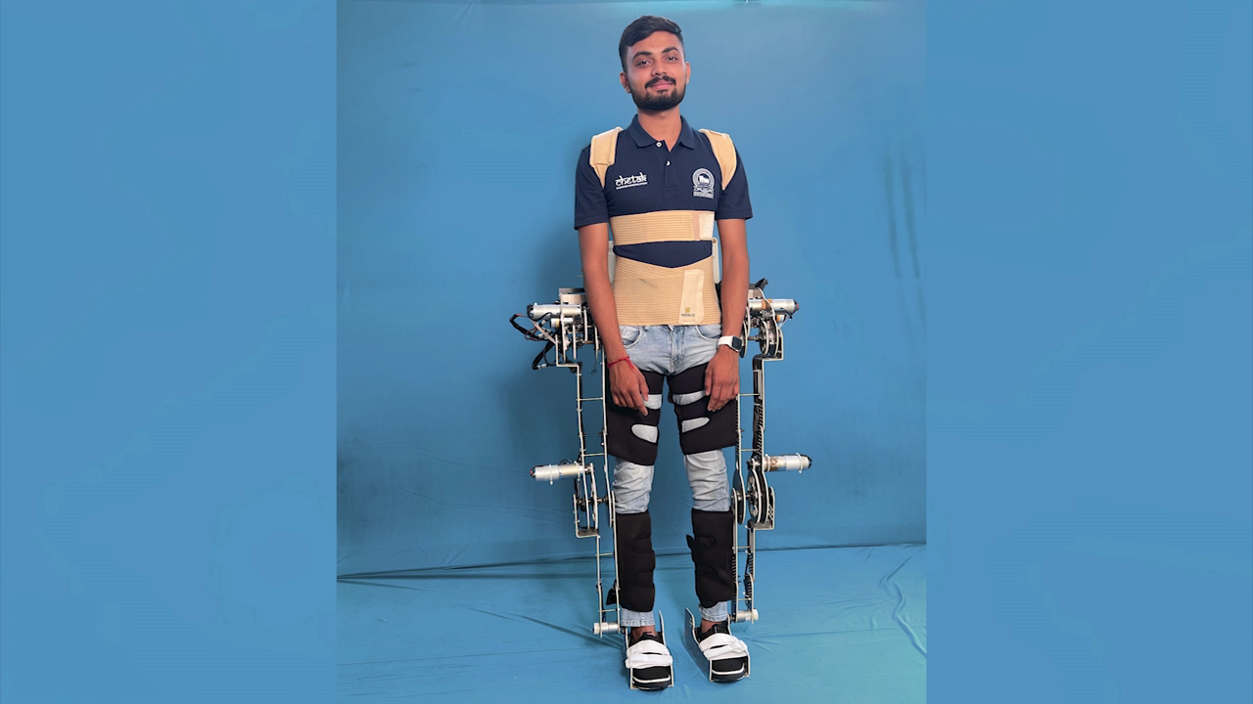
● Walking With The Exoskeleton

Slide 18
Future Scope
● Presented exoskeleton works on the predefined gait trajectory in upcoming RoboFest GujCost committee can expect to see adaptive gait trajectory according to terrain on which exoskeleton going to walk by using the trajectory optimization techniques.
● Presented exoskeleton consists of aluminium designed spur gears more futuristic gearbox options are “metal designed” harmonic drive gearbox and cycloidal gearbox.
● It’s also possible to integrate computer vision technique with the trajectory optimization technique to achieve adaptive gait trajectory.

Slide 19
References
● A. B. Zoss, H. Kazerooni and A. Chu, "Biomechanical design of the Berkeley lower extremity exoskeleton (BLEEX)," in IEEE/ASME Transactions on Mechatronics, vol. 11, no. 2, pp. 128-138, April 2006, doi: 10.1109/TMECH.2006.871087.
● Herr H. Exoskeletons and orthoses: classification, design challenges and future directions. Journal of neuroengineering and rehabilitation. 2009 Dec;6(1):1-9.
● Del-Ama AJ, Koutsou AD, Moreno JC, De-Los-Reyes A, Gil-Agudo Á, Pons JL. Review of hybrid exoskeletons to restore gait following spinal cord injury. Journal of Rehabilitation Research & Development. 2012 Jul 1;49(4).
● Nandeppagoudar SB, Shaikh SN, Gote SR, More SP, Chaudhari AS, Borse NR, Gawande SH. Design and numerical analysis of optimized planetary gear box. In6th National Conference RDME (17-18 March 2017). DOI 2017 (Vol. 10, pp. 1684-17010030511).
● Pirjade YM, Kotkar AU, Patwardhan NM, Londhe DR, Shelke TP, Ohol SS. Human Assistive Lower Limb Exoskeleton. Asian Journal For Convergence In Technology (AJCT) ISSN-2350-1146. 2019 Nov 1;5(2).
● Pirjade YM, Londhe DR, Patwardhan NM, Kotkar AU, Shelke TP, Ohol SS. Design and Fabrication of a Low-cost Human Body Lower Limb Exoskeleton. In2020 6th International Conference on Mechatronics and Robotics Engineering (ICMRE) 2020 Feb 12 (pp. 32-37). IEEE.

Slide 20

Thank You
Questions?

